Slide 1


2023 End of Year
Performance Review
Overview of Process & Timeline

Slide 2



2023 End of Year – Agenda
Timeline and Process
Instructions in Paycom for Employee and Supervisor
Instructions for non-Paycom users for Employees and Supervisor
NEW Changes for Performance Review Ratings
Performance Review Ratings and Definitions
Partners of the Americas │ November 2022 ASM
www.partners.net | @PartnersAmerica | /PartnersAmericas
Notes:
Level 5: Outstanding Results
This is the highest level of achievement.
Indicates exceptional performance and mastery of the subject or task.
The individual has gone above and beyond what is typically expected.
Demonstrates a deep understanding, creativity, and excellence in execution.
Often reserved for work that stands out as exceptional compared to the majority.

Slide 3
Important Dates (Dec 2023 to Jan 2024)
Employees
Dec 1st to Dec 15th
Supervisor
Dec 18th to Jan 10th
HR
Jan 10th to 12th
SMT & EMT
Supervisors
Week of Jan 15th
Add comments under End of Year Column
Add comments and rating for each objective
Sumit proposed rating to HR by Jan 12th
Prepares for calibration meeting
Attend the calibration meeting on Jan 16th
Share final rating with Supervisors after calibration deliberations
Jan 22nd to Jan 31st
Meet with employee to present end of year performance and
Collects data
Submit to Supervisor by Dec 16th
Finalized Review in Paycom
HR
Prepares and issue salary letters and update in Paycom
Upload payroll file for retro pay on 02/19 payroll,
New for 2023
SMT at the Calibration Meeting
Partners of the Americas │ November 2023 ASM
www.partners.net | @PartnersAmerica | /PartnersAmericas

Slide 4
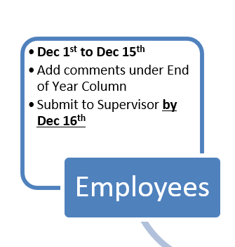
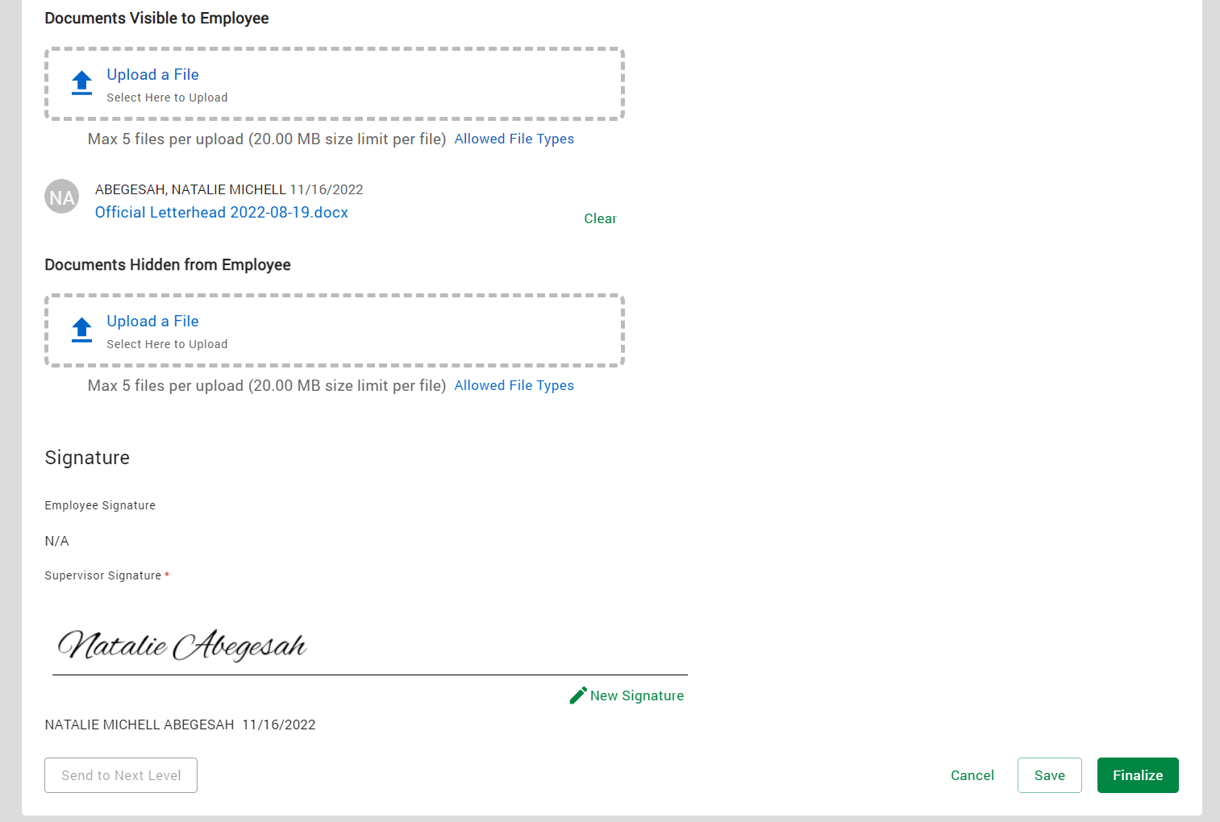
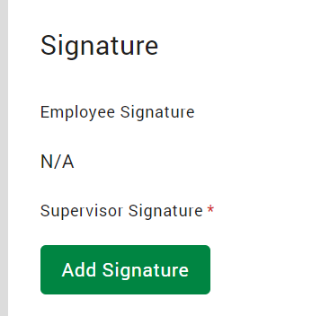
To finalize review in Paycom,
--Add your signature
--Click on Finalize
--Once Finalized
1
2
Partners of the Americas │ November 2022 ASM
www.partners.net | @PartnersAmerica | /PartnersAmericas

Slide 5
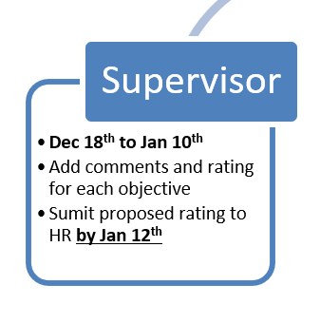
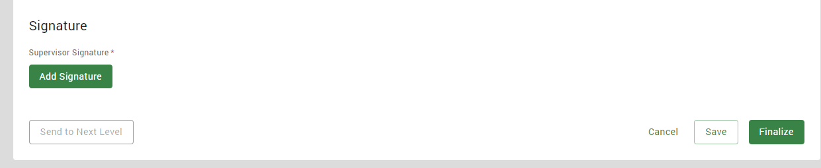
To SAVE review,
--Add your signature
--Click on SAVE
--HR will use your ratings for the calibration
Partners of the Americas │ November 2022 ASM
www.partners.net | @PartnersAmerica | /PartnersAmericas

Slide 6
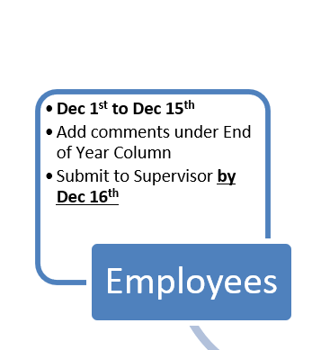
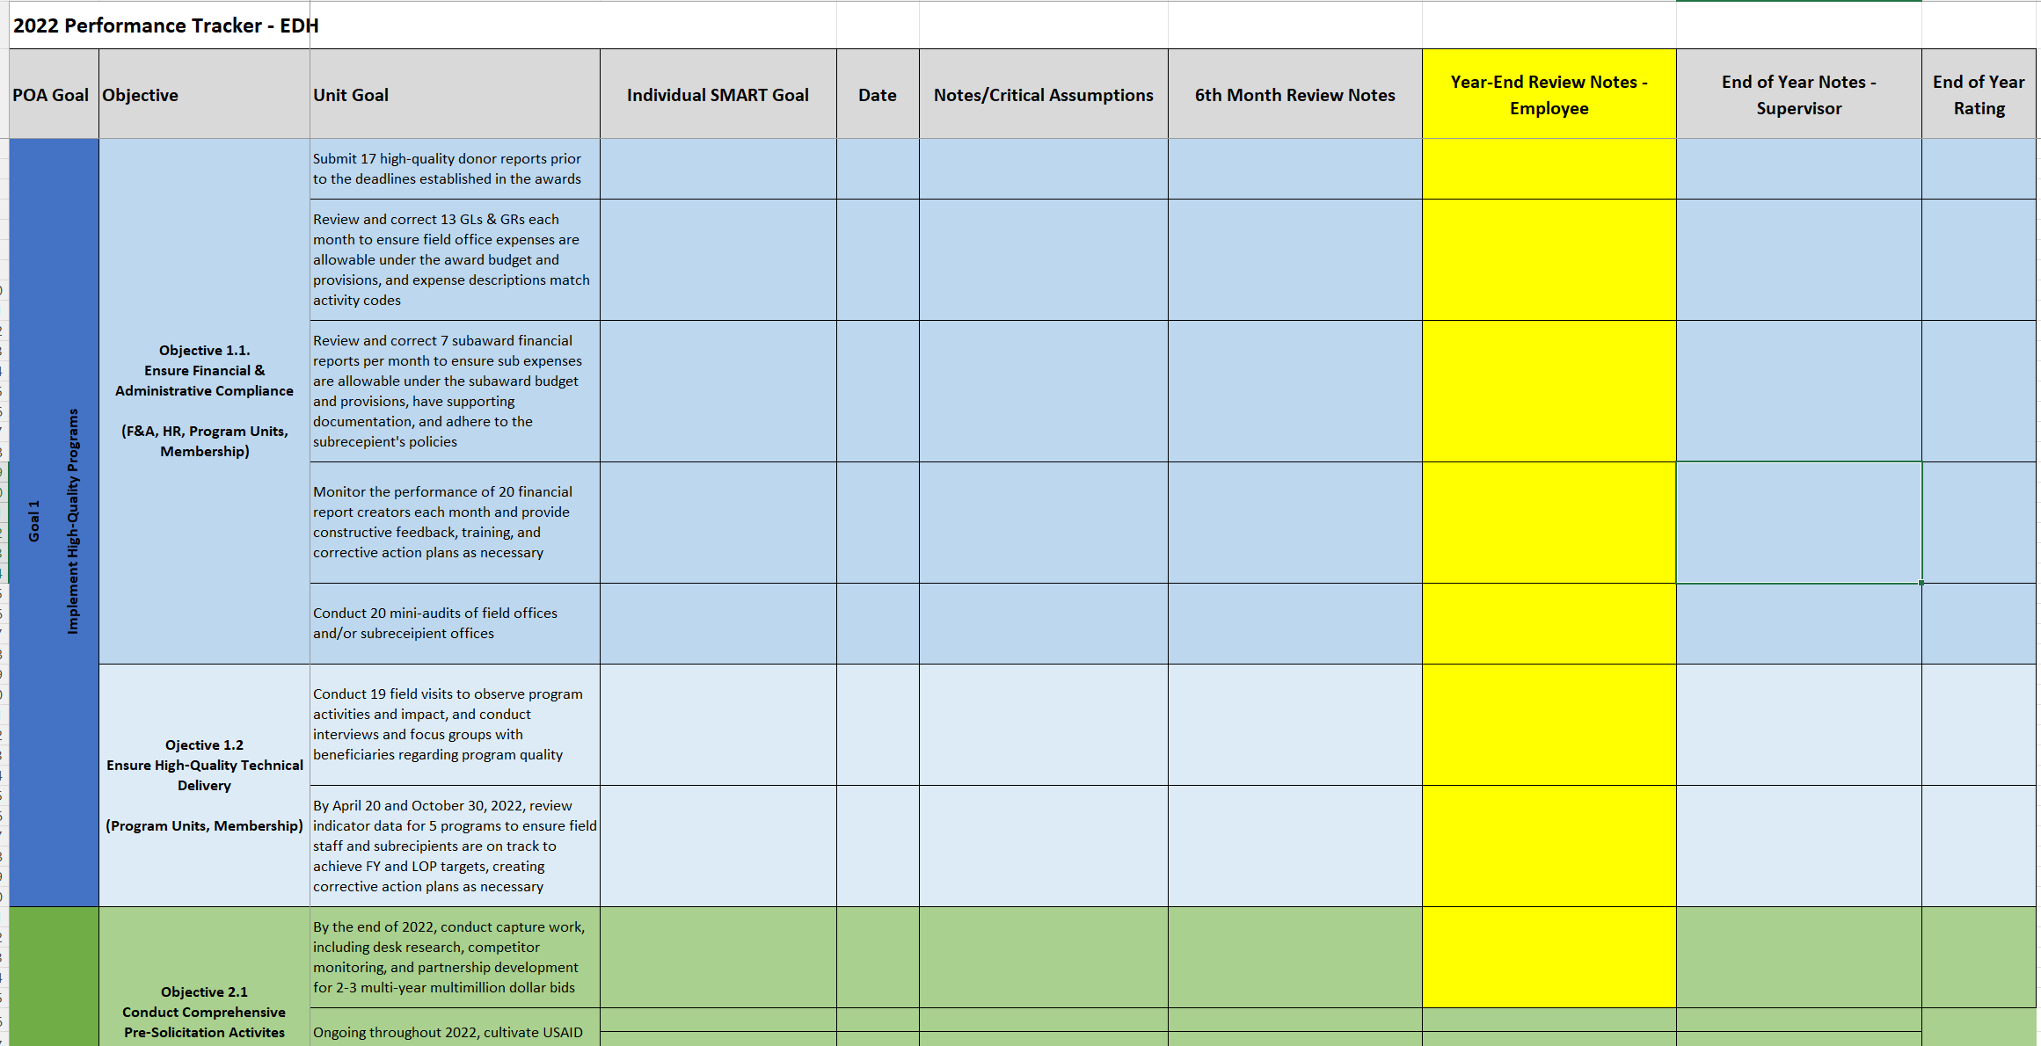
For employees that do not have access to Paycom, please use the excel template
1. Add comments under End of Year Column
Partners of the Americas │ November 2022 ASM
www.partners.net | @PartnersAmerica | /PartnersAmericas

Slide 7
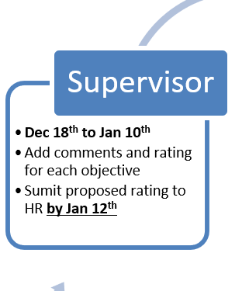
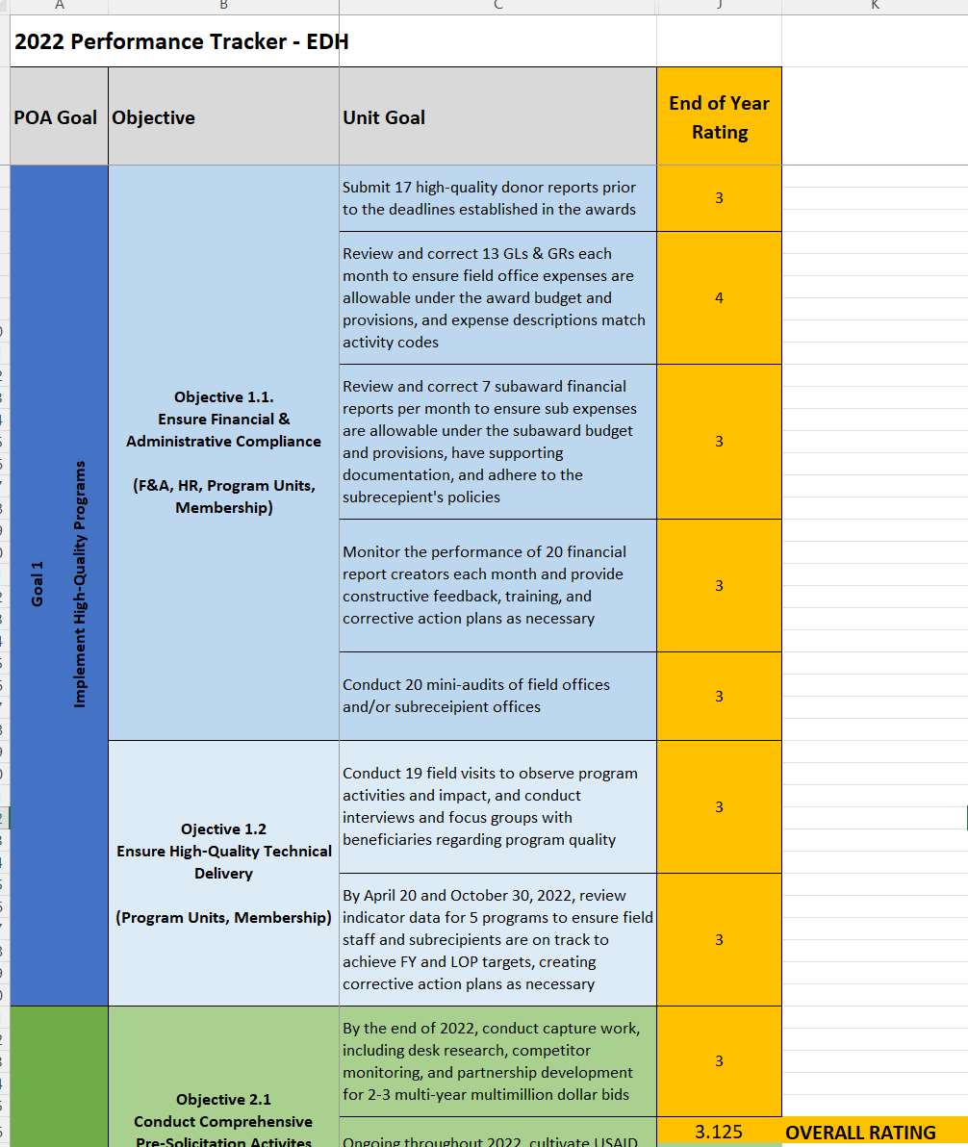
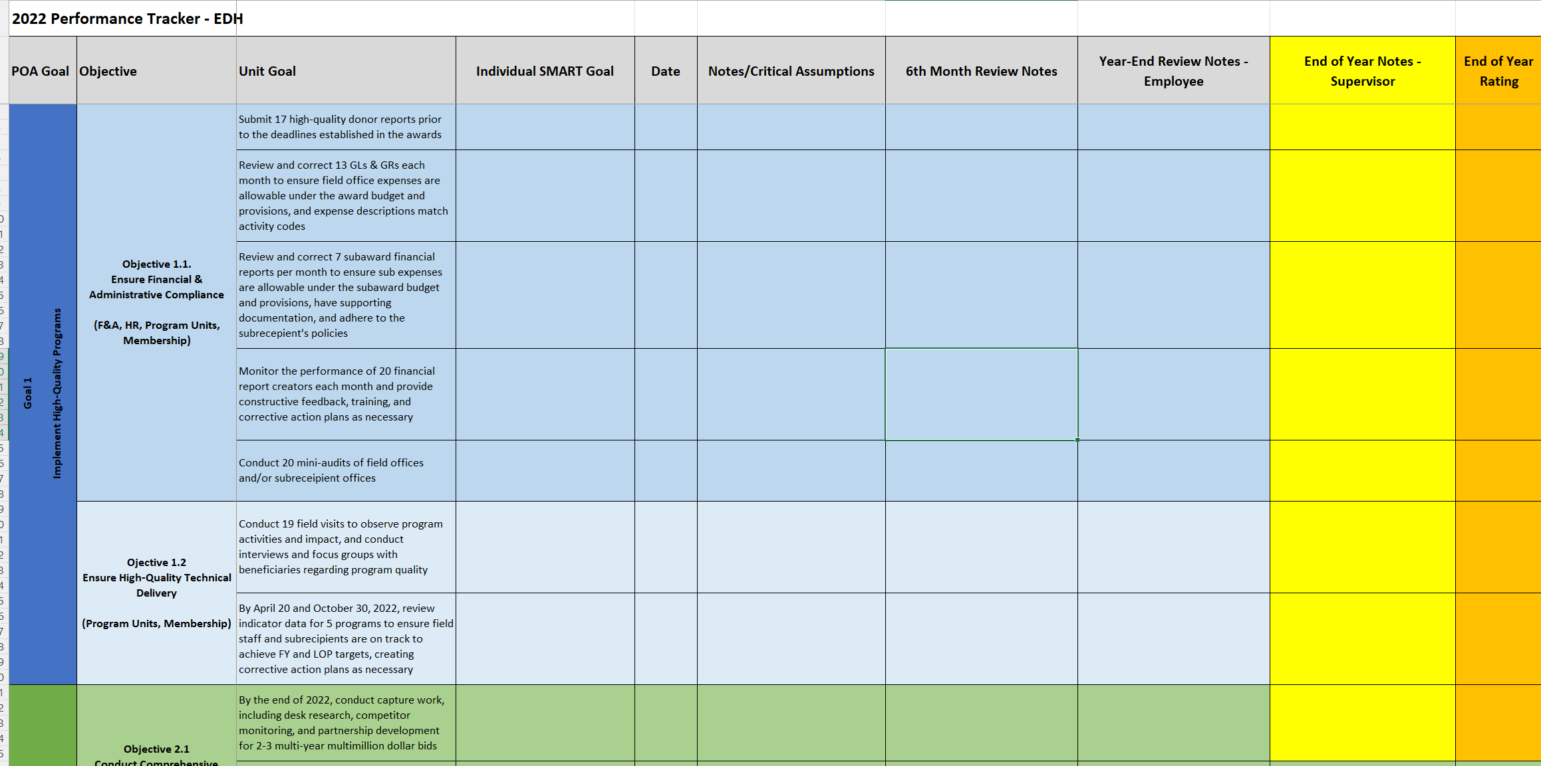
For supervisors that have employees that do not have access to Paycom, please use the excel template
3 Add all rating for each objective and divide it by the number of objectives assigned
4. Send to HR by Jan 12th completed tracker along with overall rating calculated
1. Enter End of Year Rating
2. Comments are only needed for any other rating above or below “Achieved Expected Results”
Partners of the Americas │ November 2022 ASM
www.partners.net | @PartnersAmerica | /PartnersAmericas

Slide 8
2023 Performance Levels – NEW CHANGE
New for 2023
The use of .5 points – for example 3.5
Partners of the Americas │ November 2022 ASM
www.partners.net | @PartnersAmerica | /PartnersAmericas
Notes:
Level 5: Outstanding Results
This is the highest level of achievement.
Indicates exceptional performance and mastery of the subject or task.
The individual has gone above and beyond what is typically expected.
Demonstrates a deep understanding, creativity, and excellence in execution.
Often reserved for work that stands out as exceptional compared to the majority.

Slide 9
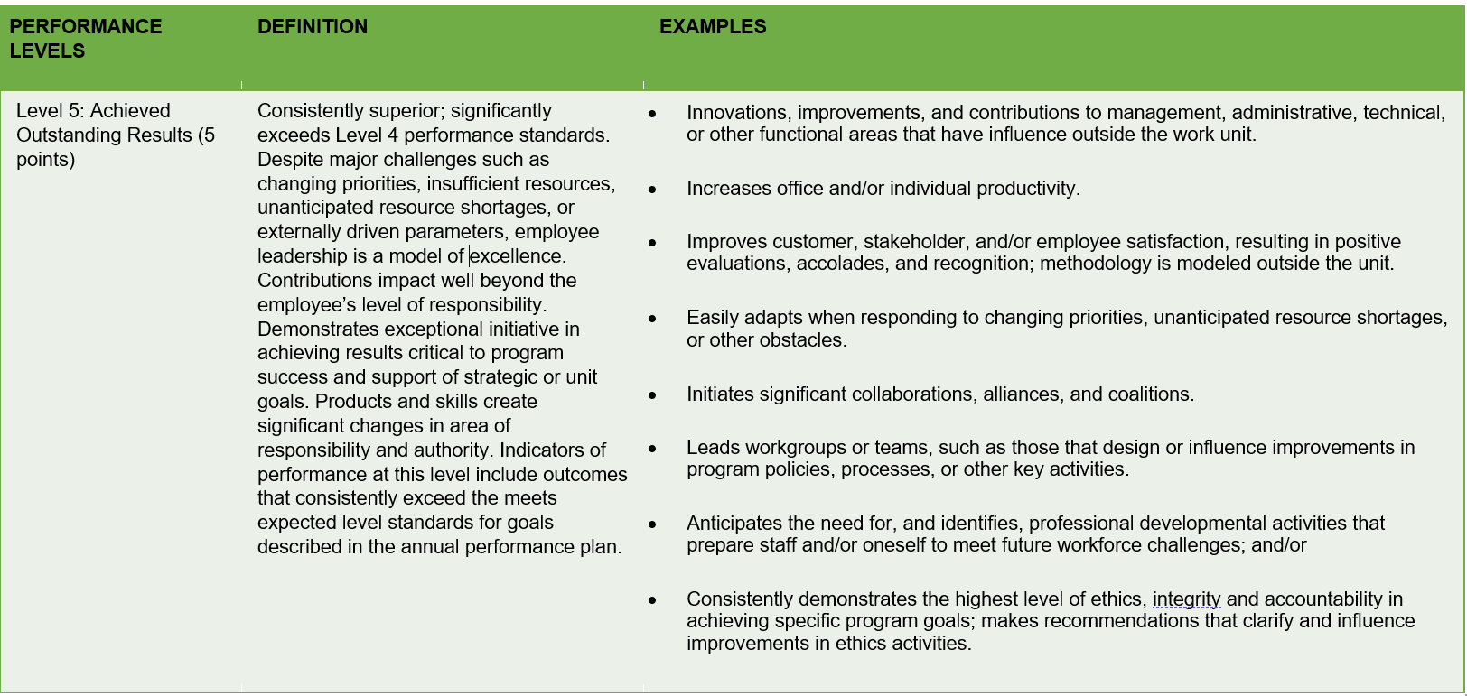
2023 Performance Levels / Rating Scale with Definitions
Partners of the Americas │ November 2022 ASM
www.partners.net | @PartnersAmerica | /PartnersAmericas
Notes:
Level 5: Outstanding Results
This is the highest level of achievement.
Indicates exceptional performance and mastery of the subject or task.
The individual has gone above and beyond what is typically expected.
Demonstrates a deep understanding, creativity, and excellence in execution.
Often reserved for work that stands out as exceptional compared to the majority.

Slide 10
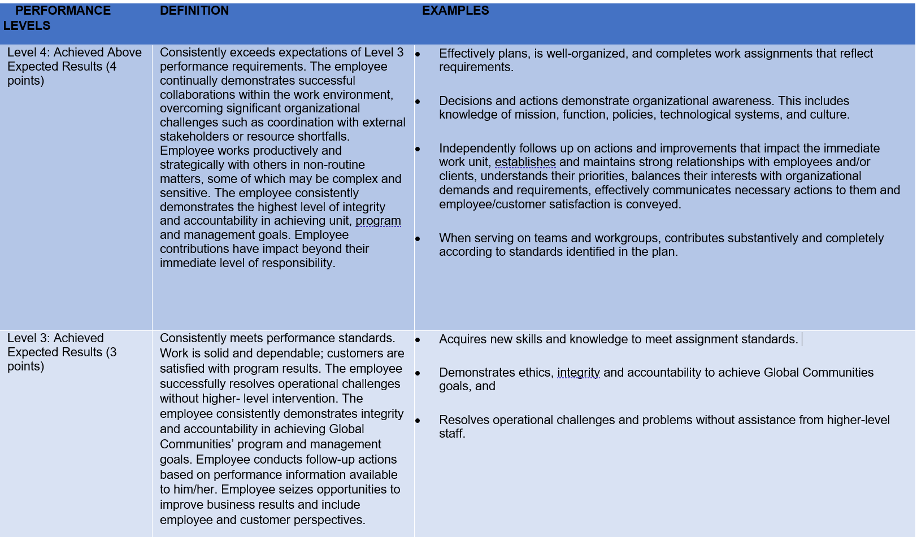
2023 Performance Levels / Rating Scale with Definitions
Partners of the Americas │ November 2022 ASM
www.partners.net | @PartnersAmerica | /PartnersAmericas
Notes:
Level 4: Above Expected Results
This level signifies performance that is above the standard or expected level.
The individual has met and exceeded the requirements for proficiency.
Indicates a strong and solid performance, demonstrating a good grasp of the material or task.
While not at the very highest level, it still represents a high level of competency and accomplishment.
Shows that the individual has not only met the expectations but has excelled in certain aspects.
In summary, Level 5 represents outstanding, exceptional achievement, while Level 4 represents performance that is above the expected or standard level. Both levels indicate a high degree of proficiency, with Level 5 being the highest tier of accomplishment.

Slide 11
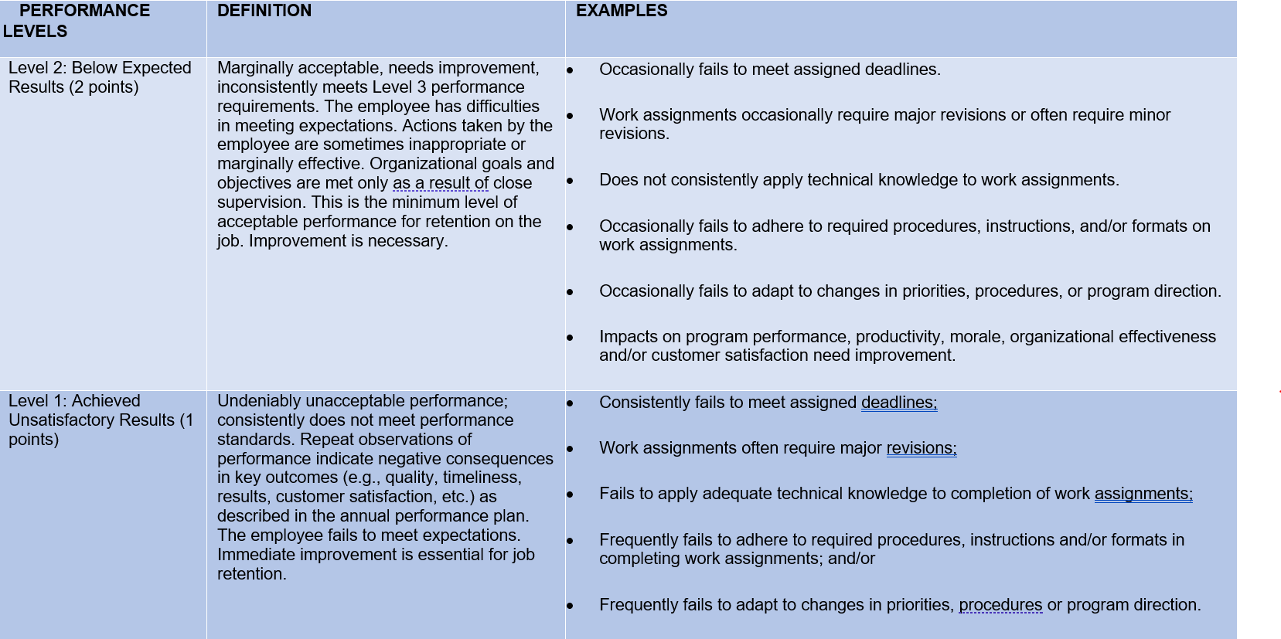
2023 Performance Levels / Rating Scale with Definitions
Partners of the Americas │ November 2022 ASM
www.partners.net | @PartnersAmerica | /PartnersAmericas

Slide 12




Questions?
Questions?
@Partners-of-the-Americas
@PartnersAmericas
@PartnersAmericas
@PartnersoftheAmericas
@PartnersAmerica
www.partners.net

